Slide 1

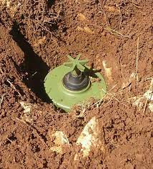

Capstone project 2-ppt for End-semester assessment-July 2022
Smart landmine detector
Division:- A
CP2_GROUP No:- A7
Day:- Friday
Date:- 12/08/2022
Presented by:-
Project Guide :-
Shweta kambare
AKOTKAR SOHAM (12111250)
AKSHAY JADHAV(12110110)
AL HUSSAIN SHAIKH(12111432)
ALDAR PRATHAMESH(12110080)
ALEKAR PRATHAM (12110935)
Department of engineering science and humanities (desh)
VISHWAKARMA INSTITUTE OF TECHNOLOGY,PUNE
Subject code: ES1038

Slide 2
INTRODUCTION
What is Landmine Detector ?
Why landmine detection is important ?
Why we need Smart Landmine Detector ?
How it’s works ?
How it is different from other landmine detector ?

Slide 3
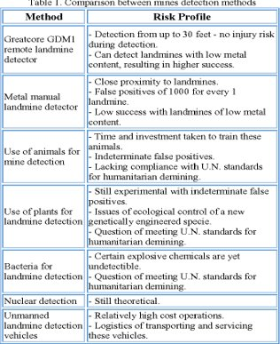
LITRATURE REVIEW
Various researches reviewed in this work showed thermography to be a good method to detect shallowly buried objects. Detection systems capable of quickly and accurately detecting buried landmines are the only possibility to significantly improve the demining process. ​
Majd Ghareeb, et.al. proposed a system for landmine detection using raspberry pi, camera board, metal detector circuit and GPS shield.​
S. Sasikumar, et.al, proposed a multi utility based landmine detecting robotic vehicle which uses metal detector as a complementary tool for landmine detection. The system consists of GPS, metal detector, microcontroller ATmega328​

Slide 4
V. Abilash and J. Paul Chandra Kumar, “Arduino Controlled Landmine Detection Robot”, International Journal of Engineering Science and Computing (IJESC), May 2017.​
NAME OF AUTHOR​ | YEAR​ | FEATURE​
Zayicek.​V.Praveen, A.Saran Kumar, G.Sivapriya, S.Priyanka | Sep 2019 | IoT and Fuzzy Logic Based Robot System
Ann goth and James Trevelyan​ | 2012​ | How do car Robo detect landmines?​
M.Siva Kumar,E.Indhuja G.Kuzhalini M.JeniferT.Infantasherly | May 2017 | Detection using GPS and Wireless Body Area Sensors Network(WBASNS),​
J. Bharath, “Automatic Landmine Detection and Sweeper Robot using Microcontroller”, International Journal of Mechanical Engineering and Robotics Research, Vol.4, No.1, Jan 2015.​

Slide 5
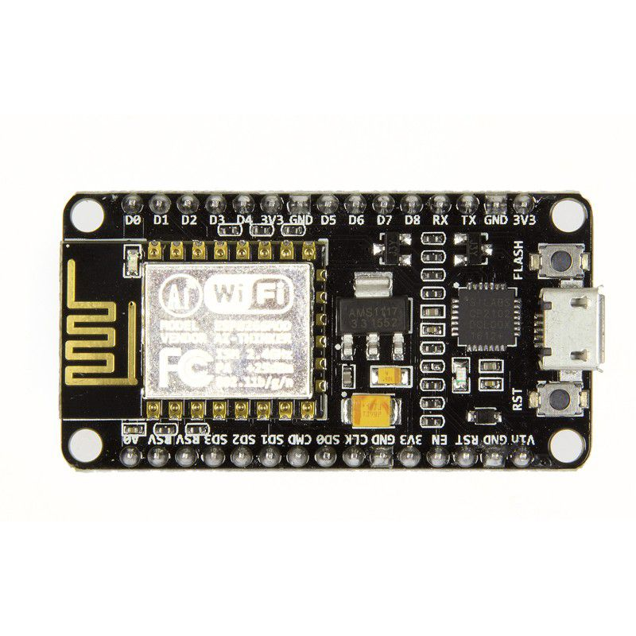
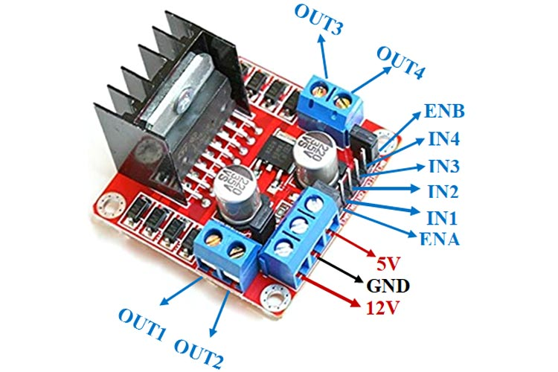
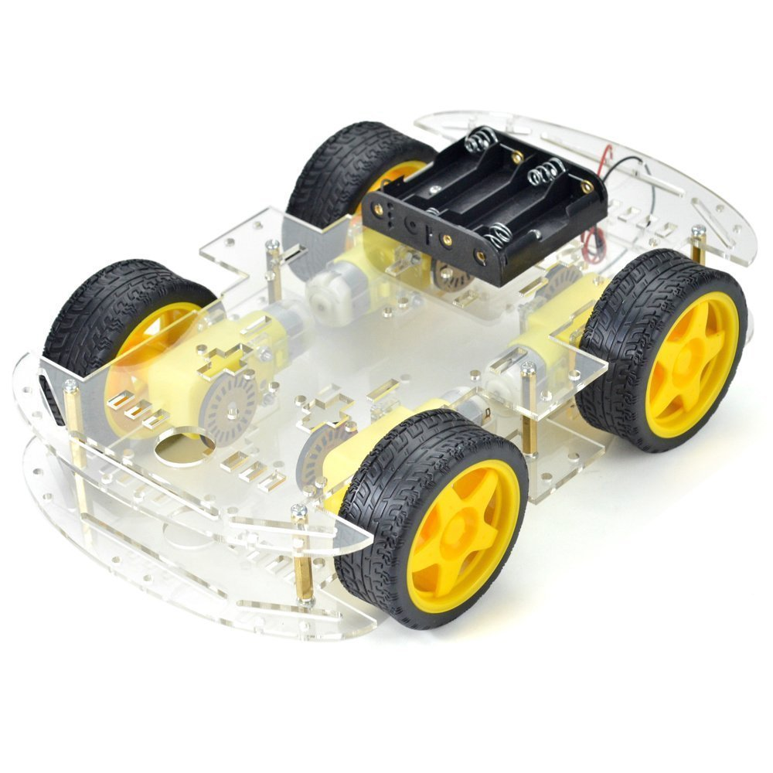
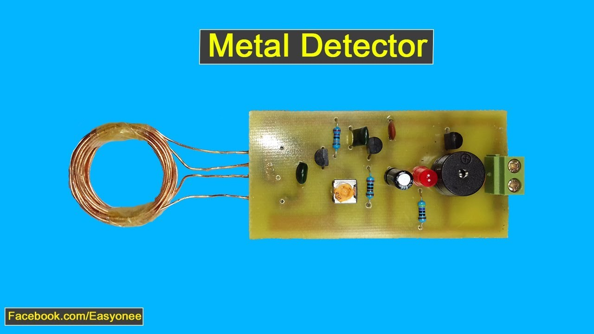
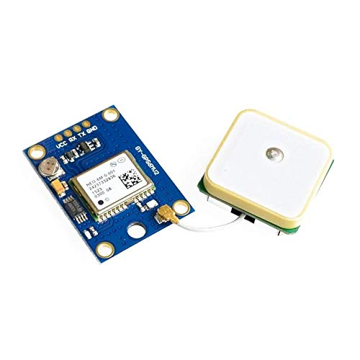

COMPONENTS AND TECHNOLOGY

Slide 6
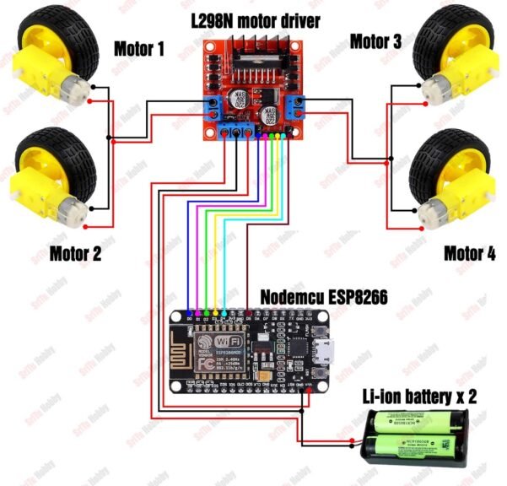
ARCHITECTURE OF OUR PROJECT
L298N | NODE MCU
EN A | D0
IN1 | D1
IN2 | D2
IN3 | D3
IN4 | D4
EN B | D5
5V | 3V3
GND | GND

Slide 7
METHORDOLOGY OF PROJECT
DESGINING THE CIRCUIT
MAKING THE CODE(EM C) TO CONTROL ROBOCAR
SETTING UP WEB AND APP DASHBOARD IN BLYNK IOT
CIRCUIT DESIGNING FOR LANDMINE DETECTION
CONTROLLING CAR USING BLYNK APP
CONNECTION TO BLYNK CLOUD
GPS TRACKING CIRCUIT
INTEGRATING ALL CIRCUITS ON NODEMCU
TESTING AND HANDING OVER TO DRDO !!!

Slide 8
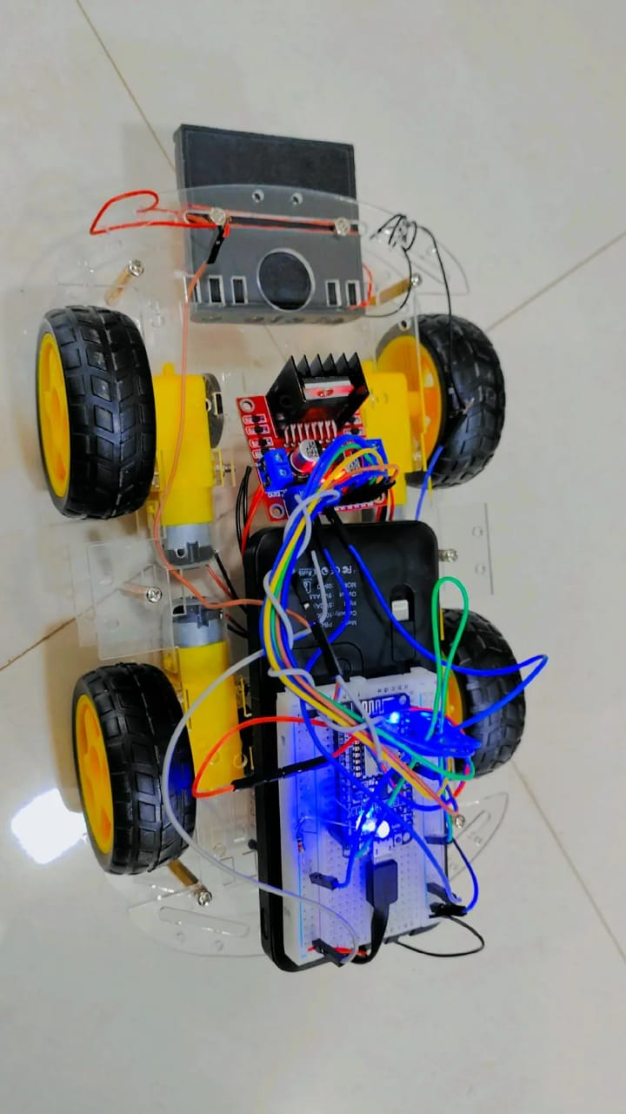
IMAGES OF OUR PROJECT

Slide 9
ADVANTAGES OF OUR PROJECT
There’s is no direct human interference so this is more safer for land mine workers(humans).
Because of its wide range humans can detect mines from the safer distance without risking there lives.
We have used GPS module so it is used to mapping land mines.
Furthermore because of GPS it becomes more precise and accurate.

Slide 10
LIMITATION OF OUR PROJECT
The maximum distance that we can search land mines is 1.5 kms w.r.t radius.
It has restriction on the terrain on which it can perform.
Battery consumption is heavy so we need to replace the battery frequently.
Location cannot be monitored in bad weather.

Slide 11
CONCLUSION
Nothing should be more important than the lives and safety of our country’s army men who risk their lives for our safety from external enemies. There have been many cases of fatalities and injuries due to explosion of landmines.
This project will save more lives of our soldiers who works in Naxalite area where more land mines are active .
There are many land mines which are not monitored by nation who have plotted them which eventually leads to death of innocent civilians of same nation

Slide 12
THANK YOU

